Slide 1
Work Breakdown Structure

Slide 2
SW
Project
SCOPE
Planning
Requirements
Design
Development
Testing
Built
Release

Slide 3
Project Management
Planning
Estimating
Scheduling
Define activities & deliverables
Time, Cost in terms of resource usage
Define sequence of tasks occurrence

Slide 4
Why is it needed?
Create WBS
Estimation techniques
Identify dependencies
For task identification
Using graph/network diagram
Create Tasks Schedule
Gantt. Chart
W.r.t size & efforts (i.e. Software productivity)
Reduced chances of project failure
Fails because of incomplete tasks’ quotation

Slide 5
What is WBS?
a work breakdown structure is:
“A hierarchical decomposition
of the total scope of work
to be carried out by the project team
to accomplish the project objectives
and create the required deliverables.”

Slide 6
WBS
Dividing complex projects to simpler and manageable tasks.
Stops till the tasks no longer remains decomposable.
Work packages are the smallest unit of work that a project can be broken down into when creating your Work Breakdown Structure (WBS).
A WBS element may be a product, data, a service, or any combination.
6

Slide 7
WBS
The WBS is a deliverable-oriented hierarchy / activity-oriented hierachy of decomposed project components.
Articulates the detailed project scope statement that specifies the work to be accomplished by the project.
WBS

Slide 8
When should we develop WBS?
Once the project Scope is decided then its needed to plan various components (activities/deliverables) of software development project.

Slide 9
How to create WBS?
Done by project mangers mostly
Determine and describe the project statement
Highlight all necessary phases in the project
Sometimes the scope is divided to different phases depending upon project
Lowest level not too detailed, not too large
Create deliverables
Check for completeness - is all the effort included?
Assign deliverables to each team
9

Slide 10
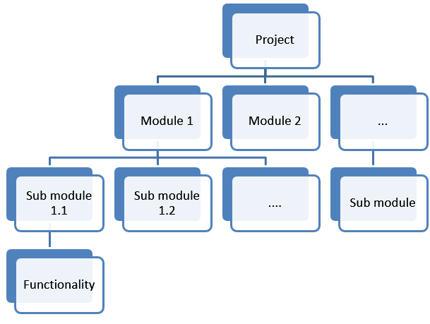
WBS

Slide 11
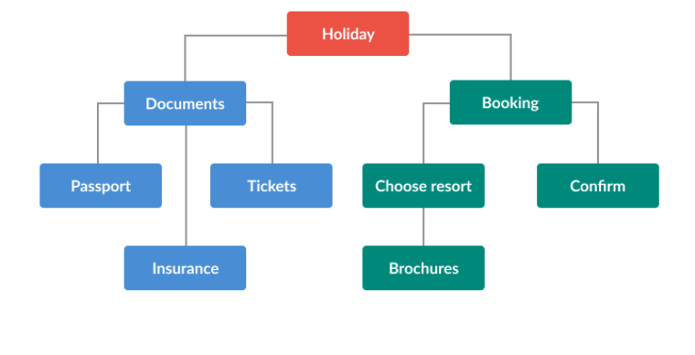
WBS
WBS

Slide 12
Reasons to use WBS
correct project organization.
depicts whole project work needed for org.
Helpful for describing the project scope to stakeholders.
God for distributing responsibilities.
Visualize each member’s activity & role in project.
shows the project milestones clearly
Helpful in cost estimation, resource allocation, and time management improvements.
Minimize unnecessary work which leads to missed deadlines out of scope work.

Slide 13
Levels in WBS
Starts with level 0 i.e. project title
Then make level 1, highest level breakdown of about 4-7 nodes depending on your project. Termed as control accounts
Then make level 2 are work packages.
Level 3 are the tasks/activities to be performed
Follow the standard numbering scheme
13

Slide 14
WBS levels
Library management Systems
Database
Front end application
Servers configuration
data structures used
Database creation
UI design
……
ER diagram

Slide 15
WBS Formats
2 Formats
Outline (Indented Format)
Graphical Tree (Organizational Chart)

Slide 16
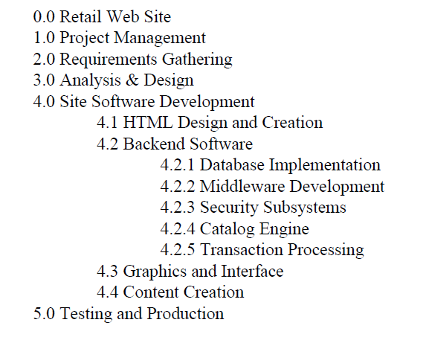
Displaying the WBS Example of outlined WBS.
16

Slide 17
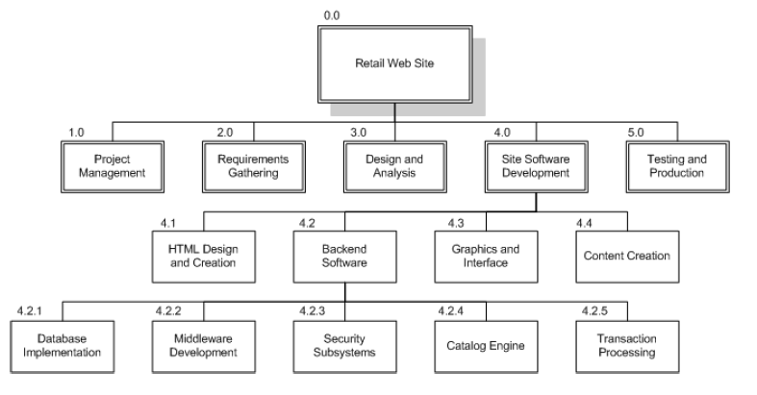
Displaying the WBS Example of Graphical Tree WBS
17

Slide 18
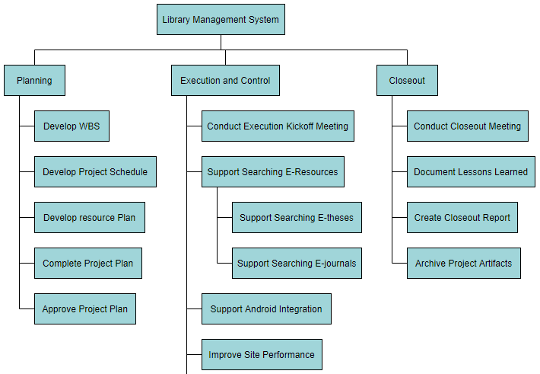
https://online.visual-paradigm.com/diagrams/features/work-breakdown-structure-software/

Slide 19
Challenges
Must have concrete knowledge of project
All tasks/ deliverables properly identified and quoted
Each task should be broken down into legit activities
19

Slide 20
The Dictionary of the WBS
A WBS dictionary is a companion document to the WBS that describes each WBS element. For each WBS element, the WBS dictionary includes a statement of work, a list of associated activities, and a list of milestones.
Other information can include:
the responsible organisation,
start and end dates,
resources required.
WBS

Slide 21
WBS Guidelines
Must be easy to understand
Ensure each element corresponds to a deliverable
Breakdown until you get accurate time and cost estimates
Covers all objectives
21

Slide 22
WBS Guidelines
Should not be much detailed as project plan
May use a template if you have
Can evolve over time
Can be drawn using Gantt Pro, Word, Excel, MS Project, Visio etc.
Each level have no more than 7 items
22

Slide 23
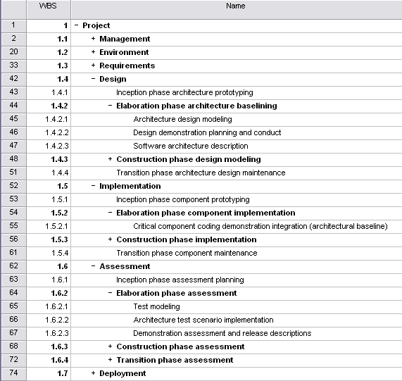
WBS Template
Component groups with a ‘+’ in front of them are ‘rolled up’ – subcomponents are hiden to reduce clutter
23

Slide 24
WBS Check List
Does it define 100% of the work that will be produced by the project?
Does it use a coding structure so that each element has a unique ID that shows its place in the hierarchy e.g. 1.1, 1.2, 1.1.1, 1.1.2?
Will project stakeholders be able to understand the project scope from the WBS?
Does each level represent 100% of the work required to deliver the parent level?
Is the decomposition sufficient that the tasks required to deliver each work package can easily be identified?
Is it in the format that gives a clear graphical, textual or tabular breakdown of the project scope?
24

Slide 25
WBS Check List
Does it have a least two levels with at least one level of decomposition?
Was it created by those who will be performing the work?
Is it being regularly updated as project changes are approved?
Can you identify one person who is accountable for each work package?
Can you clearly define the acceptance criteria for each work package?
Does it allow you to estimate costs accurately?
Does the WBS have logical summary elements that can be used in tracking progress and performance?
25

Slide 26
Example WBS
Redecorate Room
Prepare materials
Buy paint
Buy a ladder
Buy brushes/rollers
Buy wallpaper remover
Prepare room
Remove old wallpaper
Remove detachable decorations
Cover floor with old newspapers
Cover electrical outlets/switches with tape
Cover furniture with sheets
Paint the room
Clean up the room
Dispose or store left over paint
Clean brushes/rollers
Dispose of old newspapers
Remove covers
WBS

Slide 27
Professional Tools used
https://www.projectmanager.com/
https://www.atlassian.com/software/jira
https://ganttpro.com/

Slide 28
Ease Travel App : Case Study
After much deliberation and watching people wait silently and suffer, the company was founded in 2021 to provide a solution whereby one could track designated rides while they were on the way and avoid the physical and mental discomfort of waiting on the road for the ride to arrive. EaseTravel app is a trip tracking service for daily commuters and essentially to be used for people using hired transport services for daily intra-city traveling. This application has two main users: the driver and the daily commuter. After analysis some findings conclude that most of the Vehicle drivers are novice users and reluctant to embrace any technology so, the developing company must create user-interface accordingly. Onboard screen has all the basic features needed to fulfill the objectives of user. Such as, log-in, forget password; setting new-password after verification user will get into the application to make vehicle selection, this option only appears one-time for drivers who have multiple vehicles assigned to them. They can change the vehicle anytime; the home screen displays the vehicle selected. To be clicked when you need to change the vehicle, starting a journey, The APP automatically marks Arrived when the driver reaches a stop. Attendance automatically opens with all travelers marked present, only need to mark absentee, pop-up: ride complete, making calls Occasional - When needed. Same goes for the daily commuter until login, afterwards the home screen displays the passenger selected. To be clicked when need to change the passenger. (In case of multiple passengers associated with an account), tracking services will be available to ensure the safety. On reaching the destination the screen will pop with a successful ride! Message. There are some complementary features like: previous ride history and delay and cancellation of ride, passenger no-show notification as well.

